Slide 1

Now these people were more noble than those in Thessalonica, for they received the word with all readiness of mind, examining the scriptures daily to see whether these things were so (Acts 17:11).
Beloved, do not believe every spirit. Instead, test the spirits to see whether they are from God, because many false prophets have gone out into the world (1 John 4:1).
All Scripture taken from the English Unlocked Literal Bible (ULB), ©2017, 2022 Wycliffe Associates, Available at https://bibleineverylanguage.org/translations, licensed under the Creative Commons Attribution-ShareAlike 4.0 International License.
The English ULB is based on the unfoldingWord® Literal Text, CC BY-SA 4.0. The original work of the unfoldingWord® Literal Text is available at https://unfoldingword.bible/ult/.
Quality Assessment

Slide 2
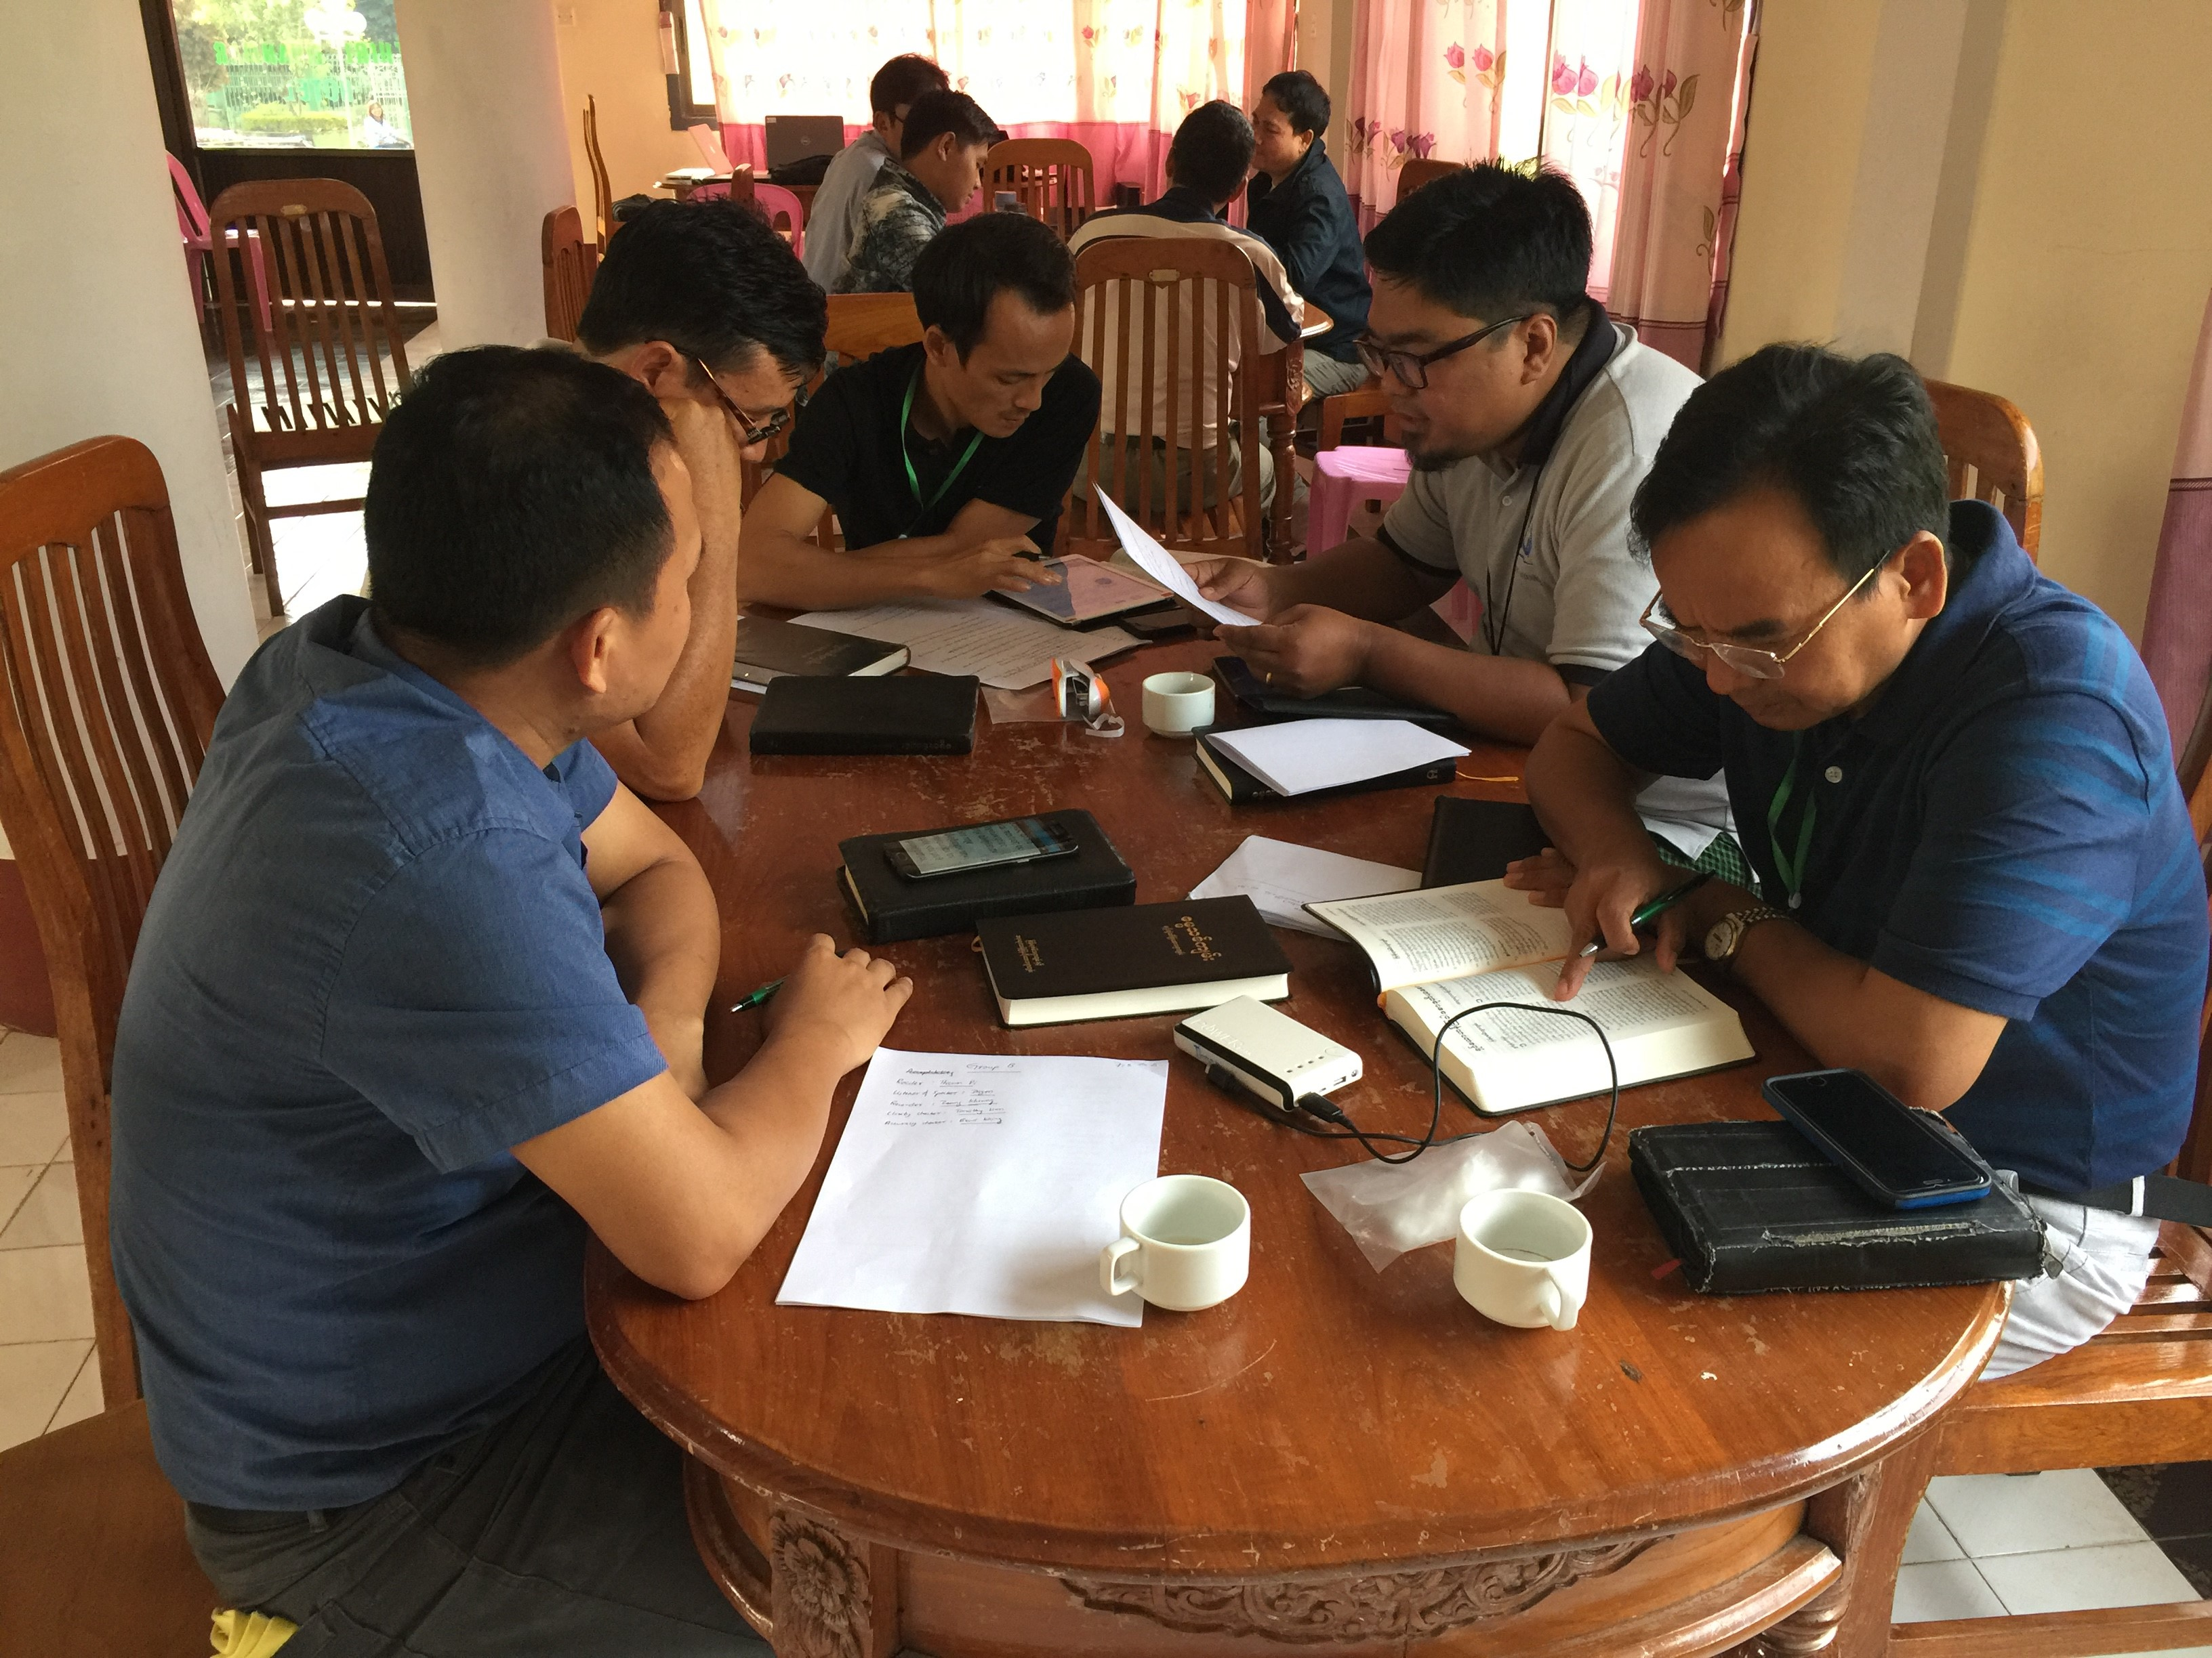
Is it ready?
Keyword
Check
Self-edit
Peer-edit

Slide 3
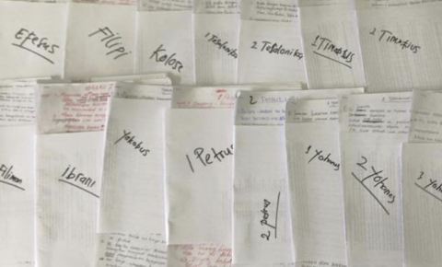



Is it ready?
Keyword
Check
Self-edit
Peer-edit
Quality
Accuracy
Clarity
Local Church
Naturalness
Standard

Slide 4
Quality Assessment Guide
Qualities
________________
________________
________________
Definitions
________________
________________
________________
Questions
________________
________________
Yes or No
________________

Slide 5

Quality Assessment Guide
Qualities
Definitions
Questions
Accurate
Correct style
Clear
Natural
Faithful
Historical
Grammatically correct
Other qualities
________________
________________
________________
________________
________________
________________
________________
________________
________________
________________
________________
________________
________________
________________
________________
________________

Slide 6
Quality Assessment Guide
Quality
Accurate
________________
________________
________________
Definition
The meaning of the translation is the same as the meaning of the source text.
Nothing is added.
Nothing is missing.

Slide 7
Quality Assessment Guide
Quality
Correct Style
________________
Definition
The translation uses the same style as the source text.
• Poetry is expressed as poetry, narrative (story) as narrative, etc.
• Prophecy is not explained.
• Teaching sounds like teaching.
  The tone (or emotion) is consistent with the source text.

Slide 8
Quality Assessment Guide
Quality
Clear
________________
Definition
The language and wording are simple and direct.
• When read, its meaning is easy to understand.

Slide 9
Quality Assessment Guide
Quality
Natural
________________
Definition
The translation uses language and style that is common.
• The translation sounds the way people talk or write.

Slide 10
Quality Assessment Guide
Quality
Faithful
________________
Definition
The translation does not favor one opinion over another in theology.
• There is no denominational bias, such as adjusted wording to support a particular baptism practice.

Slide 11
Quality Assessment Guide
Quality
Historical
________________
Definition
The translation maintains the geography, environment, and time of the source text.
• Names of people and places are consistent and correct.
• Plants and animals are accurate to the historical environment of the Scripture.

Slide 12
Quality Assessment Guide
Quality
Grammatically Correct
_____________________________
Definition
The grammar and punctuation of the target language is consistent and
correct.
• Capitalization and punctuation rules are followed.
• Spelling and grammar are correct.

Slide 13

What other qualities are needed in a translation?

Slide 14
What makes a good translation?
List Qualities
Give Objective Definitions
Ask Questions
Yes
No

Slide 15
Try it
Matthew 1:18–25

